Slide 1
Tutorial 1 Creating a Database

Slide 2
Objectives
Session 1.1
Learn basic database concepts and terms
Start and exit Access
Explore the Microsoft Access window and Backstage view
Create a blank database
Create and save a table in Datasheet view
Enter field names and records in a table datasheet
Open a table using the Navigation Pane

Slide 3
Objectives (Cont.)
Session 1.2
Open an Access database
Copy and paste records from another Access database
Navigate a table datasheet
Create and navigate a simple query
Create and navigate a simple form
Create, preview, navigate, and print a simple report
Use Help in Access
Learn how to compact, back up, and restore a database

Slide 4
Creating a Database
Case - Chatham Community Health Services
All Tutorials use this Case
A nonprofit health clinic located in Hartford, Connecticut, specializes in the areas of pulmonology, cardiac care, and chronic disease management
Cindi Rodriguez, the office manager for Chatham Community Health Services, oversees a small staff and is responsible for maintaining the medical records of the clinic’s patients

Slide 5
Creating a Database (Cont.)
Case - Chatham Community Health Services
Cindi and her staff rely on electronic medical records for patient information, billing, inventory control, purchasing, and accounts payable
The clinic recently upgraded to Microsoft Access 2013 (or simply Access)
Using the software to enter, maintain, and retrieve related data in a format known as a database

Slide 6
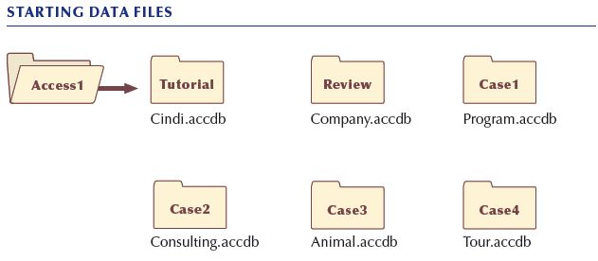
Creating a Database (Cont.)

Slide 7
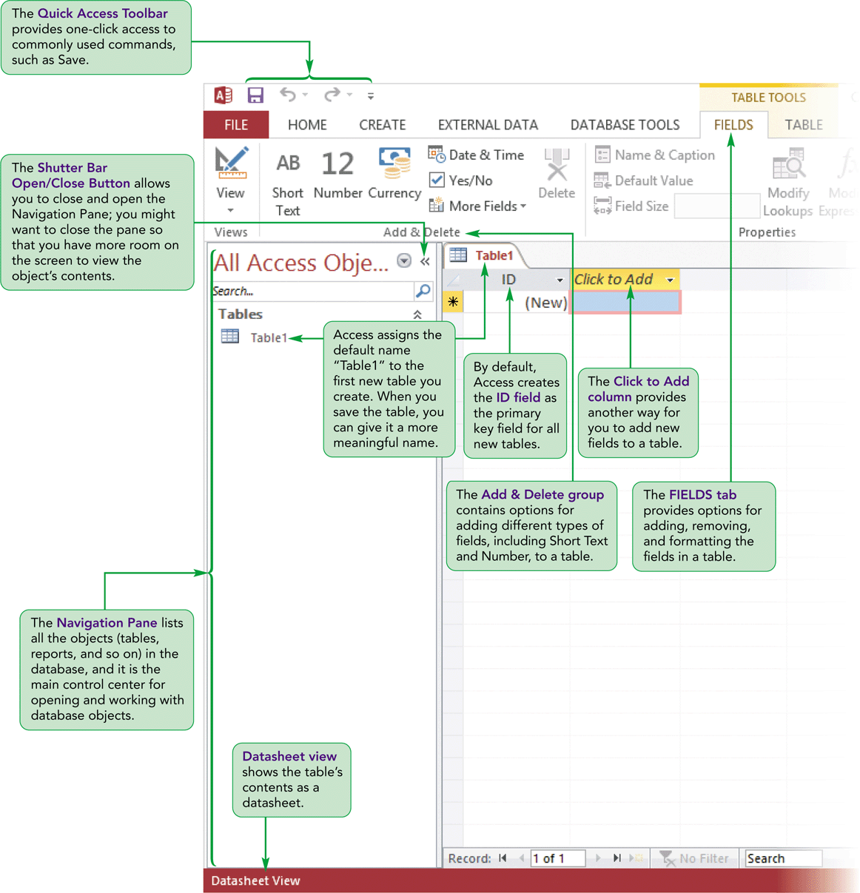
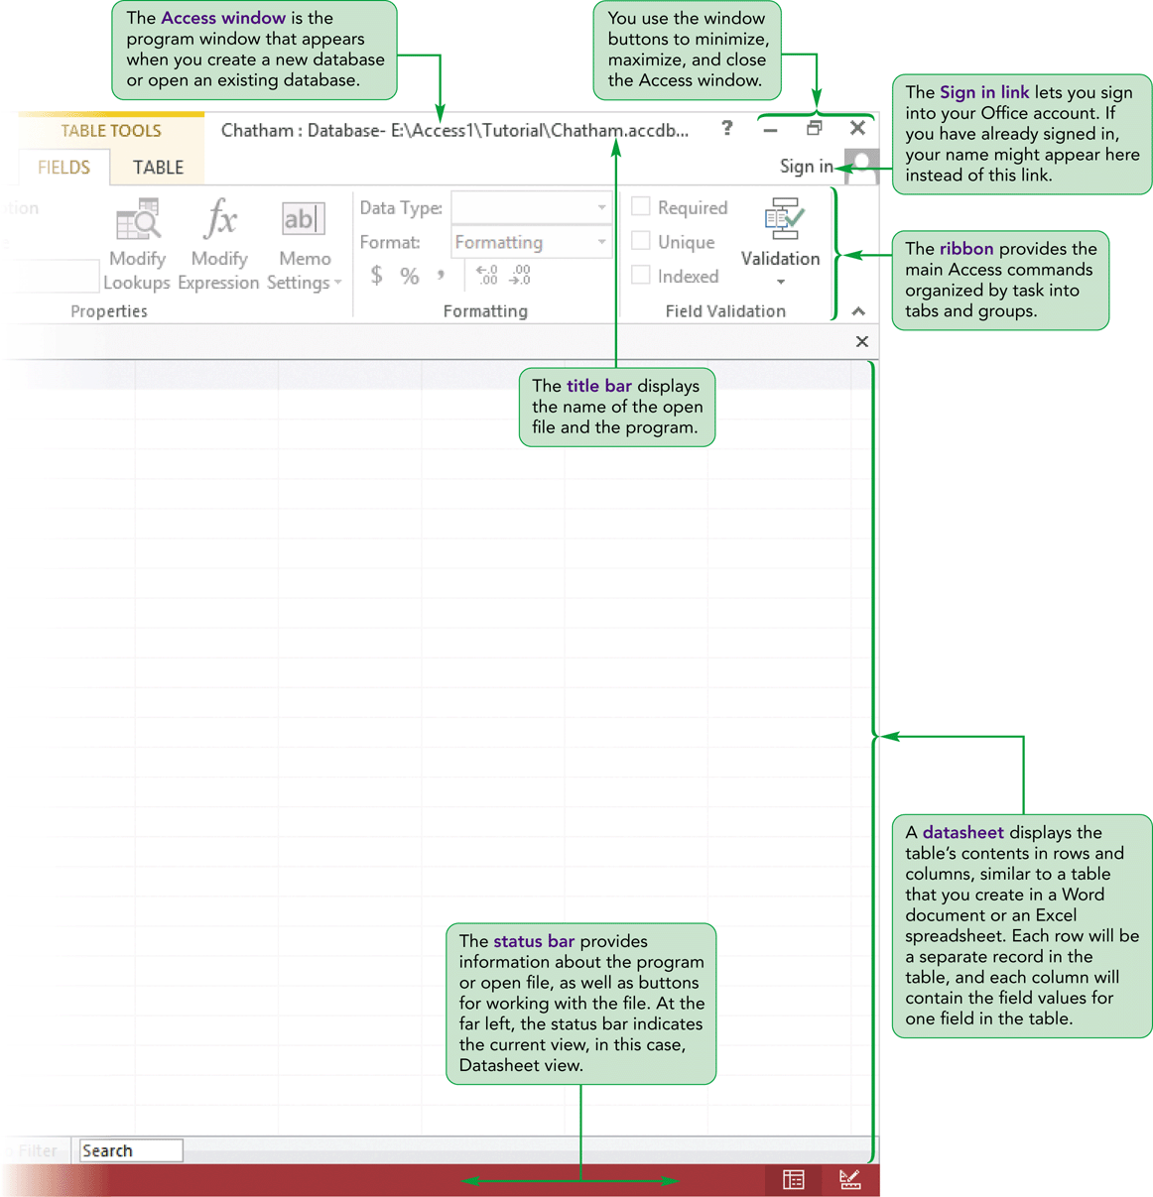
Creating a Database (Cont.)

Slide 8
Introduction to Database Concepts
Organizing Data
A field is a single characteristic or attribute of a person, place, object, event, or idea
Patient ID, first name, last name, address, phone number, visit date, reason for visit, and invoice amount
Related fields are grouped together into a table
A collection of fields that describes a person, place, object, event, or idea
The specific content of a field is called the field value
his set of field values is called a record

Slide 9
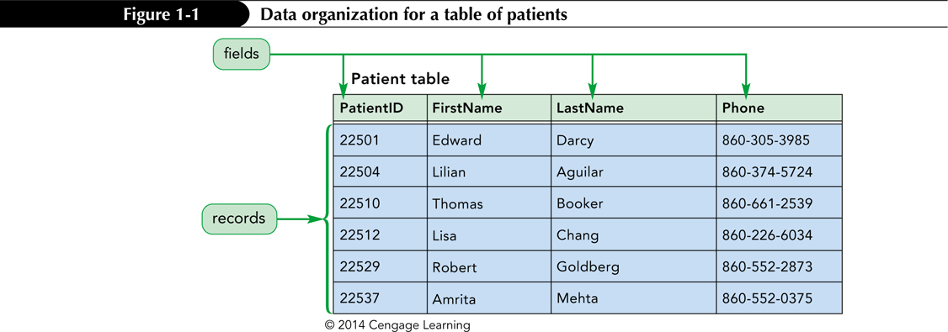
Introduction to Database Concepts (Cont.)

Slide 10
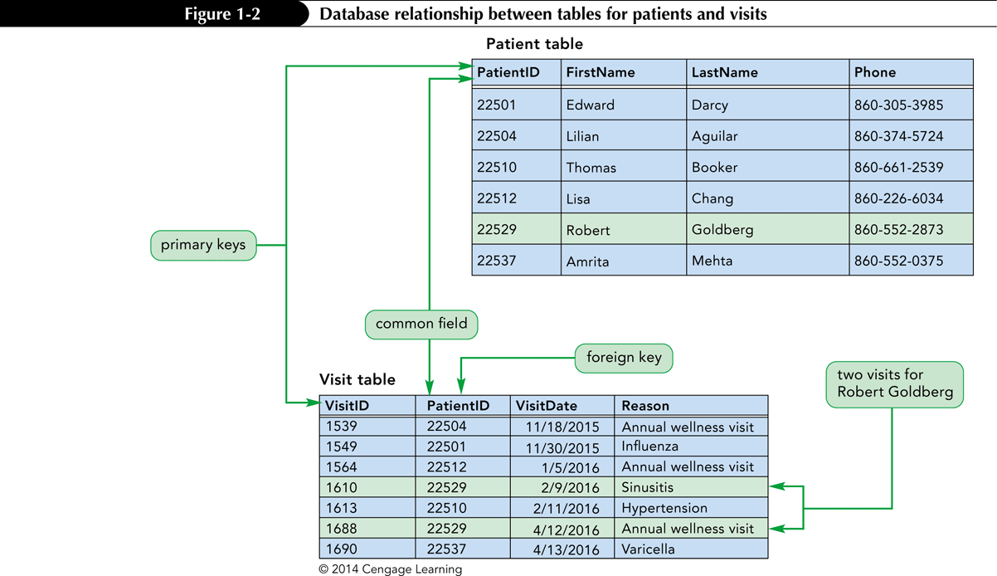
Databases and Relationships
A relational database is a collection of related tables
Records in the separate tables are connected through a common field
A primary key is a field, or a collection of fields, that uniquely identify each record in a table
Including the primary key from one table as a field in a second table to form a relationship between the two tables, it is called a foreign key in the second table

Slide 11
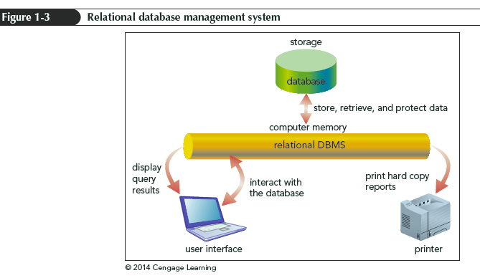
Relational Database Management Systems
A database management system (DBMS) is a software program that lets you create databases and then manipulate the data they contain
In a relational database management system, data is organized as a collection of tables. A relational DBMS controls the storage of databases and facilitates the creation manipulation, and reporting of data

Slide 12
Relational Database Management Systems
A relational DBMS provides the following functions:
Allows you to create database structures containing fields, tables, and table relationships
Lets you easily add new records, change field values in existing records, and delete records
Contains a built-in query language, which lets you obtain immediate answers to the questions (or queries) you ask about your data
Contains a built-in report generator, which lets you produce professional-looking, formatted reports from your data
Protects databases through security, control, and recovery facilities

Slide 13
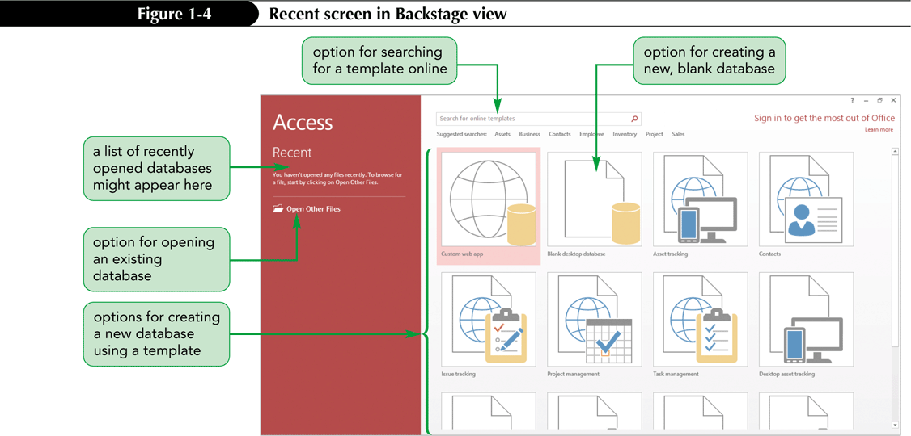
Starting Access and Creating a Database

Slide 14
Starting Access and Creating a Database (Cont.)
When you start Access, the first screen that appears is Backstage view which contains commands that allow you to manage Access files and options
The Recent screen in Backstage view provides options for you to create a new database or open an existing database
To create a new database that does not contain any data or objects, you use the Blank desktop database option
Use a template (a predesigned database that includes professionally designed tables, reports, and other database objects) If the database contains objects that match those found in common databases, such as databases that store data about contacts or tasks

Slide 15
Working in Touch Mode
If you are working on a touch device, such as a tablet, you can switch to Touch Mode in Access to make it easier for you to tap buttons on the ribbon and perform other touch actions
To switch to Touch Mode:
On the Quick Access Toolbar, click the Customize Quick Access Toolbar button and make sure the Touch/Mouse Mode is selected (shaded red to indicate that it is selected) The display switches to Touch Mode with more space between the commands and buttons on the ribbon

Slide 16
Creating a Table in Datasheet View
On the ribbon, click the CREATE tab
In the Tables group, click the Table button
Rename the default ID primary key field and change its data type, if necessary; or accept the default ID field with the AutoNumber data type
In the Add & Delete group on the FIELDS tab, click the button for the type of field you want to add to the table and then type the field name; Repeat this step to add all the necessary fields to the table
In the first row below the field names, enter the value for each field in the first record, pressing the Tab or Enter key to move from one field to the next
After entering the value for the last field in the first record, press the Tab or Enter key to move to the next row, and then enter the values for the next record.
On the Quick Access Toolbar, click the Save button, enter a name for the table, and then click the OK button

Slide 17
Creating a Table in Datasheet View (Cont.)

Slide 18
Creating a Table in Datasheet View (Cont.)
Decision Making: Naming Fields in Access Tables
One of the most important tasks in creating a table is deciding what names to specify for the table’s fields. Keep the following guidelines in mind when you assign field names:
A field name can consist of up to 64 characters, including letters, numbers, spaces, and special characters, except for the period (.), exclamation mark (!), grave accent (`), and square brackets ([ ])
A field name cannot begin with a space
Capitalize the first letter of each word in a field name that combines multiple words, for example VisitDate
Use concise field names that are easy to remember and reference, and that won’t take up a lot of space in the table datasheet
Use standard abbreviations, such as Num for Number, Amt for Amount, and Qty for Quantity, and use them consistently throughout the database.
For example, if you use Num for Number in one field name, do not use the number sign (#) for Number in another
Give fields descriptive names so that you can easily identify them when you view or edit records

Slide 19
Creating a Table in Datasheet View (Cont.)
Renaming the Default Primary Key Field
To rename the ID field to the VisitID field:
Right-click the ID column heading to open the shortcut menu, and then click Rename Field. The column heading ID is selected, so that whatever text you type next will replace it
Type VisitID and then click the row below the heading. The column heading changes to VisitID, and the insertion point moves to the row below the heading
Notice that the TABLE TOOLS tab is active on the ribbon. This is a contextual tab, which appears and provides options for working with objects selected

Slide 20
Creating a Table in Datasheet View (Cont.)
Changing the Data Type of the Default Primary Key Field
Notice the Formatting group on the FIELDS tab (One of the options available in this group is the Data Type option)
Each field in an Access table must be assigned a data type
The data type determines what field values you can enter for the field
The AutoNumber data type automatically inserts a unique key for every record, beginning with the number 1 for the first record, the number 2 for the second, etc.

Slide 21
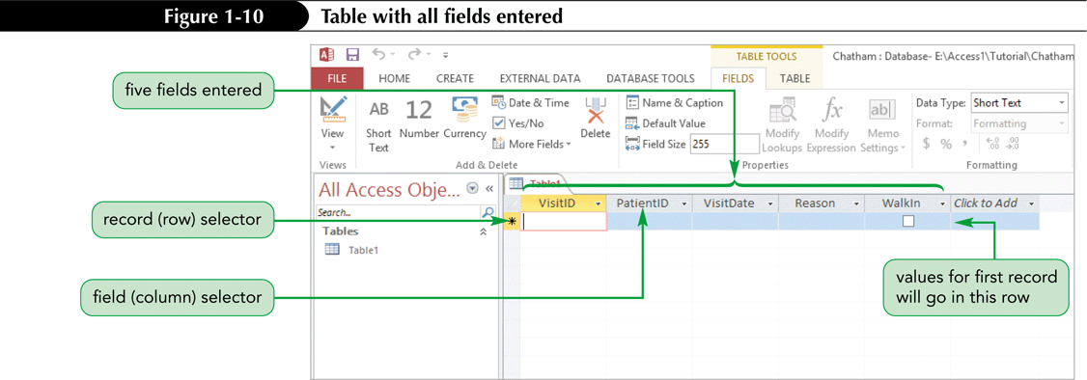
Creating a Table in Datasheet View (Cont.)
Adding New Fields
When you create a table in Datasheet view, you can use the options in the Add & Delete group on the FIELDS tab to add fields to your table
You can also use the Click to Add column in the table datasheet to add new fields

Slide 22
Creating a Table in Datasheet View (Cont.)
Datasheet view shows a table’s contents in rows (records) and columns (fields)
Each column is headed by a field name inside a field selector
Each row has a record selector to its left
Clicking a field selector or a record selector selects that entire column or row (respectively)
A field selector is also called a column selector
A record selector is also called a row selector

Slide 23
Creating a Table in Datasheet View (Cont.)
Entering Records

Slide 24
Creating a Table in Datasheet View (Cont.)

Slide 25
Creating a Table in Datasheet View (Cont.)
Saving a Table
Records you enter are immediately stored in the database as soon as you enter them
However, the table’s design—the field names and characteristics of the fields themselves, plus any layout changes to the datasheet—are not saved until you save the table
When you save a new table for the first time, you should give it a name that best identifies the information it contains
Like a field name, a table name can contain up to 64 characters, including spaces

Slide 26
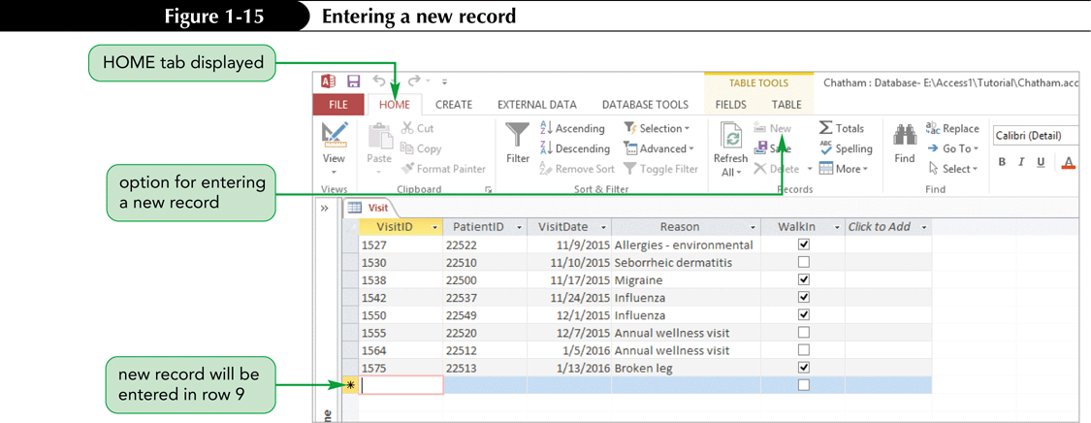
Creating a Table in Datasheet View (Cont.)
Entering Additional Records

Slide 27
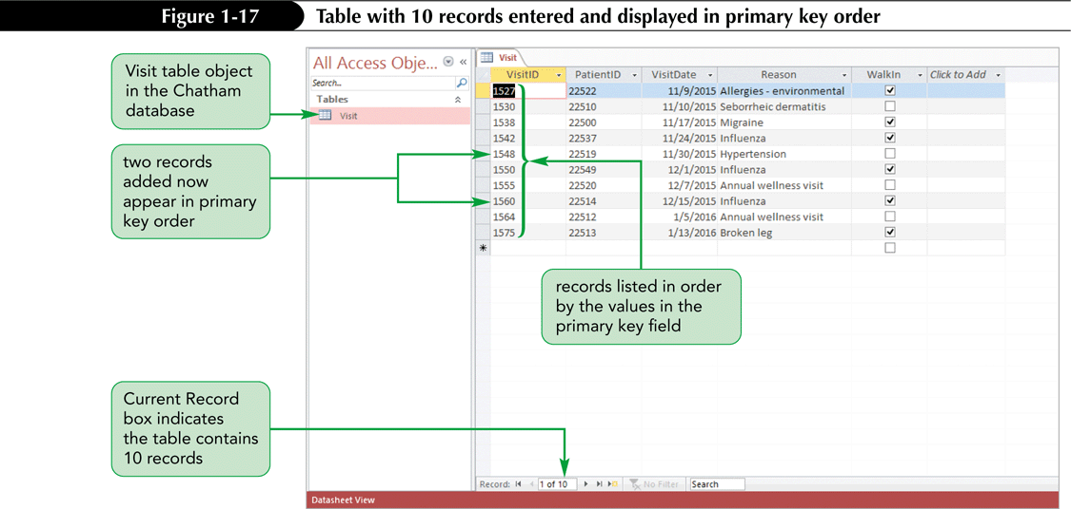
Creating a Table in Datasheet View (Cont.)
Opening a Table
The tables in a database are listed in the Navigation Pane. You open a table, or any Access object, by double-clicking the object name in the Navigation Pane

Slide 28
Closing a Table and Exiting Access
Close a table by clicking its Close button on the object tab, as you did earlier
If you want to close the Access program as well, you can click the program’s Close button
When you do, any open tables are closed, the active database is closed, and you exit the Access Program
If you want to close a table without exiting Access, click the FILE tab to display Backstage view, and then click Close

Slide 29
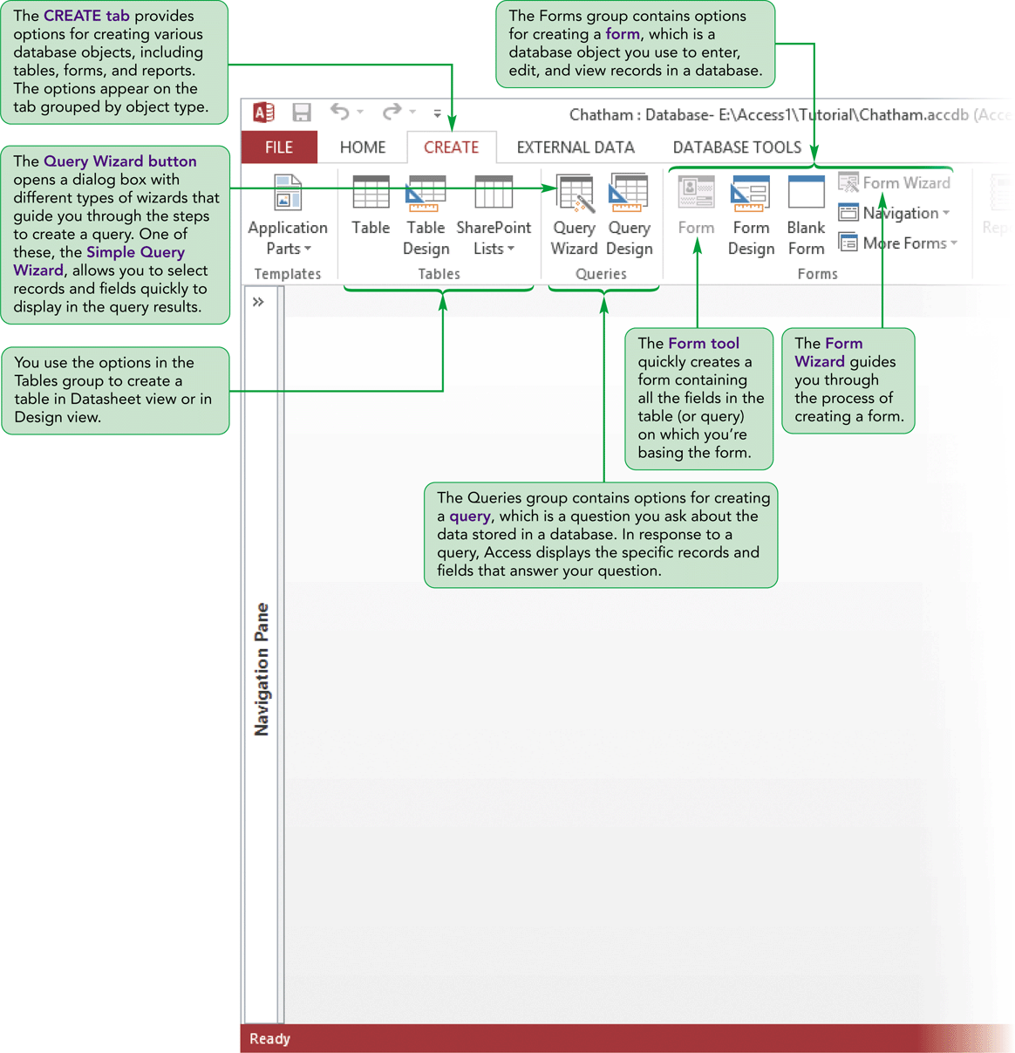
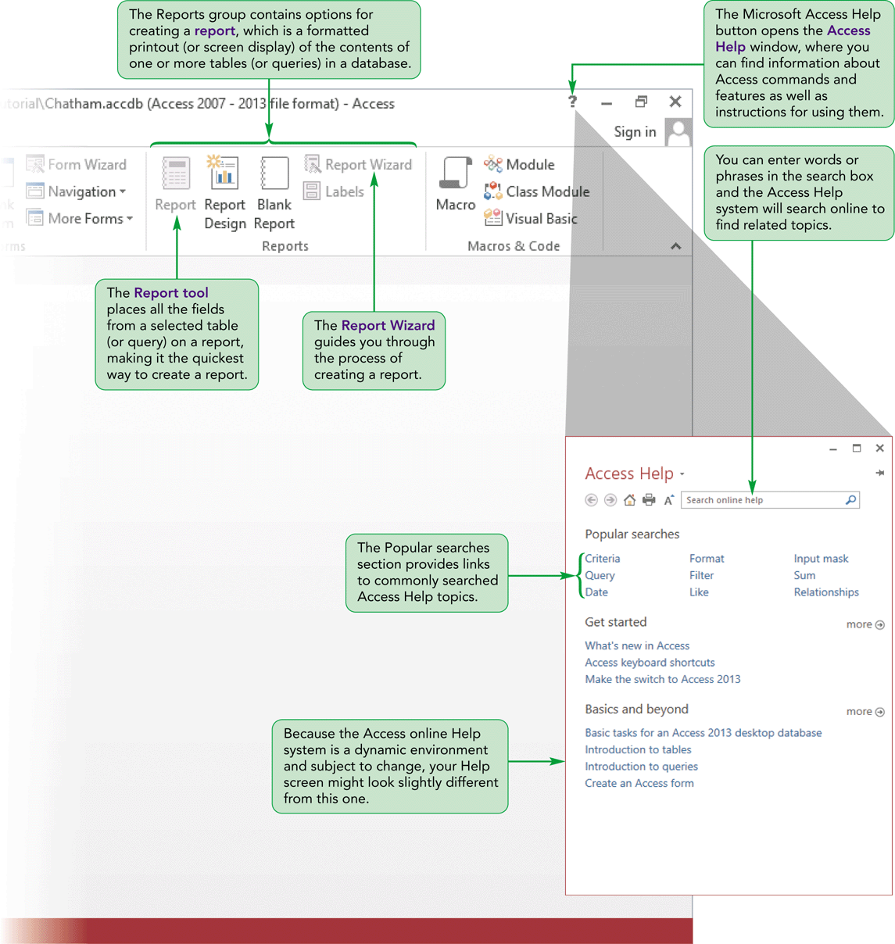
Creating a Database (Cont.)

Slide 30
Copying Records from Another Access Database
There are many ways to enter records in a table, including copying and pasting records from a table into the same database or into a different database
The two tables must have the same structure—that is, the tables must contain the same fields, with the same design, in the same order
Cindi has already created a table named Appointment that contains additional records with visit data
The Appointment table is contained in a database named Cindi located in the Access1 Tutorial folder included with your Data Files
The Appointment table has the same table structure as the Visit table you created

Slide 31
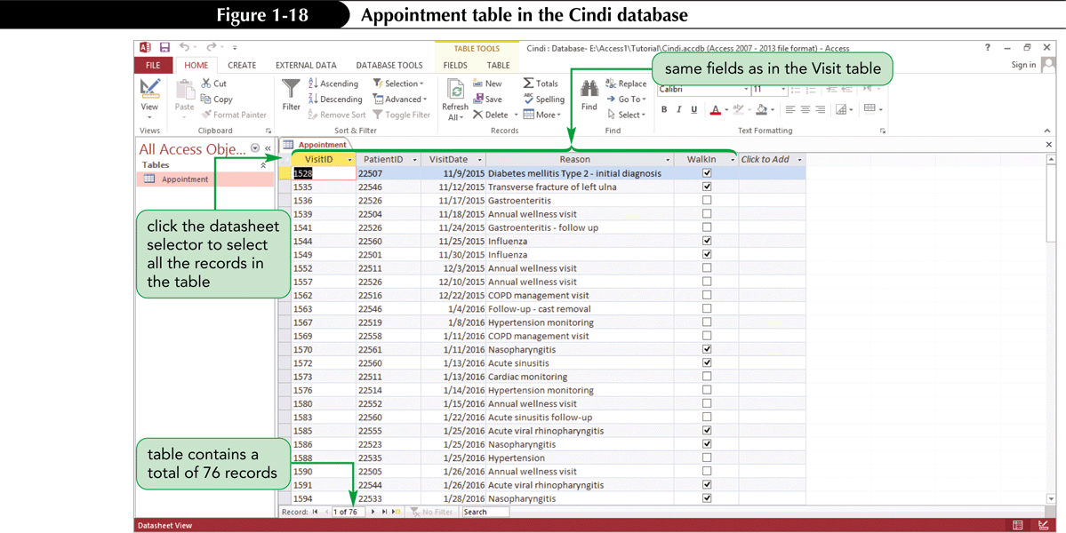
Copying Records from Another Access Database (Cont.)

Slide 32
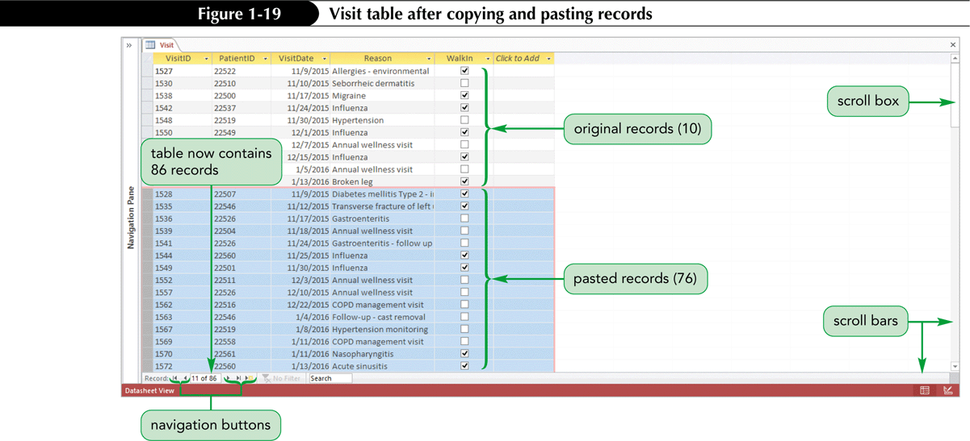
Copying Records from Another Access Database (Cont.)

Slide 33
Navigating a Dataset
Navigation buttons provide another way to move vertically through the records
The Current Record box appears between the two sets of navigation buttons
Displays the number of the current record as well as the total number of records in the table
The New (blank) record button works in the same way as the New button on the HOME tab

Slide 34
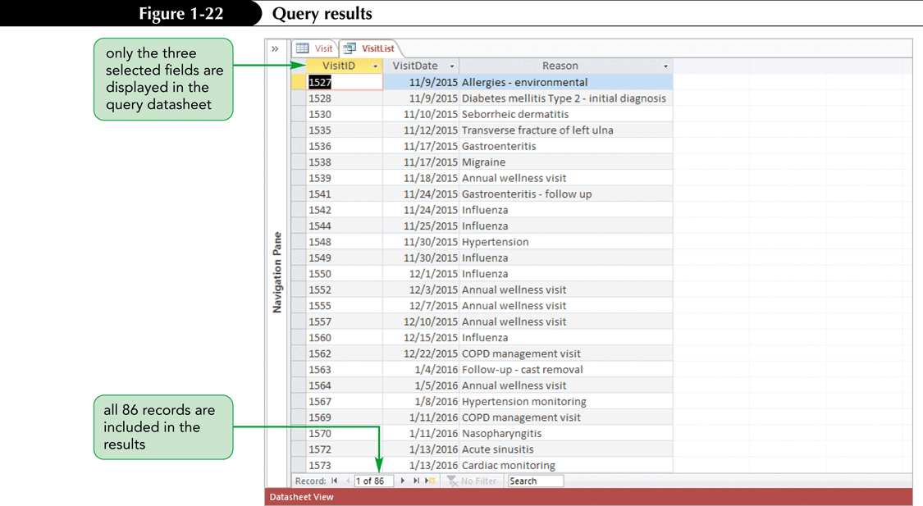
Creating a Simple Query (Cont.)

Slide 35
Creating a Simple Form
Forms display one record at a time
Provide another view of the data that is stored in the table
Allowing you to focus on the values for one record
Access displays the field values for the first record in the table
Each field appears on a separate line
As indicated in the status bar, the form is displayed in Layout view
In Layout view, you can make design changes to the form while it is displaying data, so that you can see the effects of the changes you make immediately

Slide 36
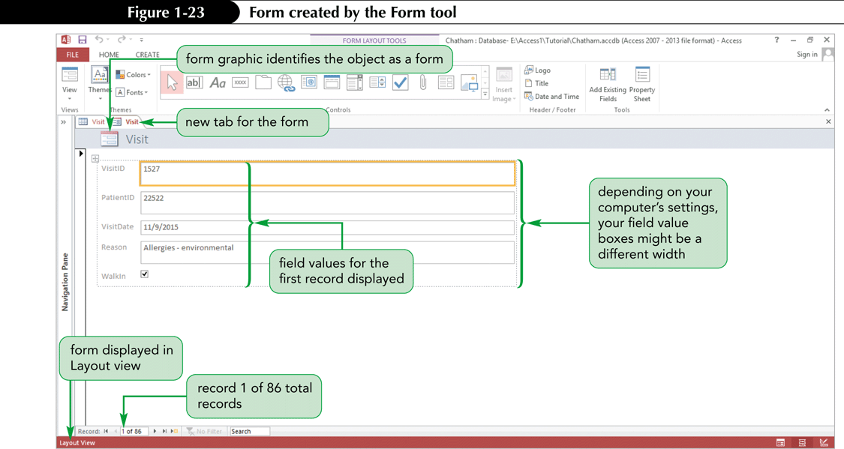
Creating a Simple Form (Cont.)
Use a form to enter, edit, and view records in a database
Although you can perform these same functions with tables and queries, forms can present data in many customized and useful ways

Slide 37
Creating a Simple Report
A report is a formatted printout (or screen display) of the contents of one or more tables or queries
Reports show each field in a column, with the field values for each record in a row, similar to a table or query datasheet
Reports offers a more visually appealing format for the data, with the column headings in a different color, borders around each field value, a graphic of a report at the top left, and the current day, date, and time at the top right

Slide 38
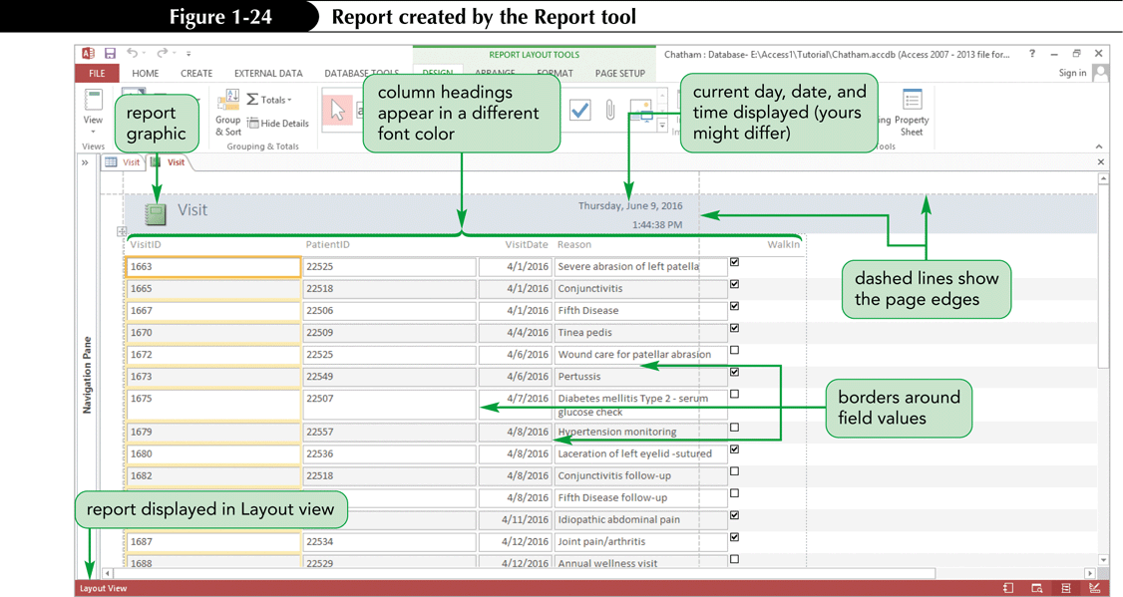
Creating a Simple Report (Cont.)

Slide 39
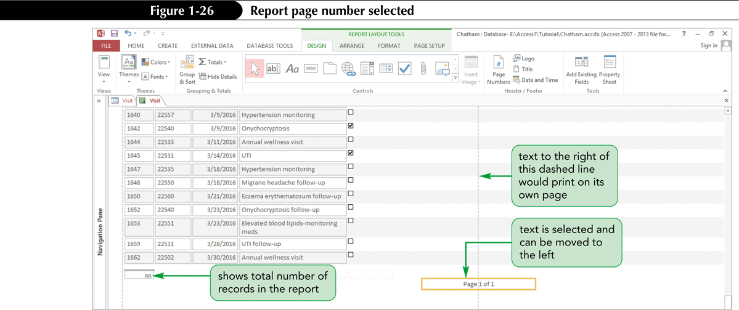
Creating a Simple Report (Cont.)

Slide 40
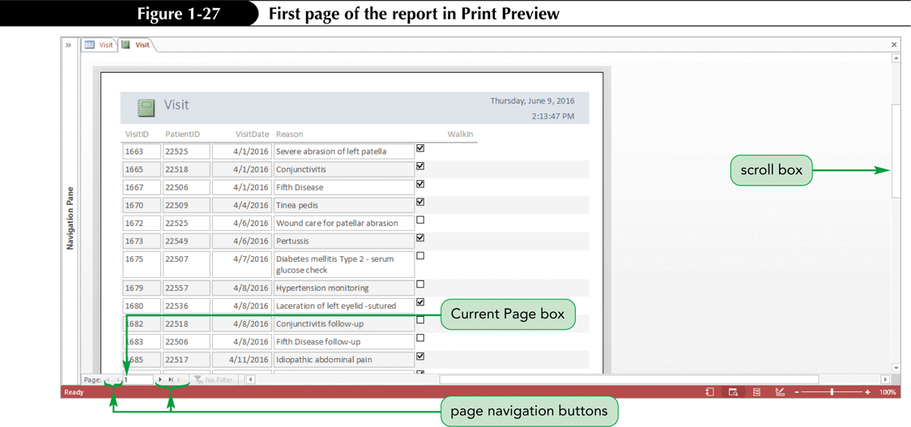
Creating a Simple Report (Cont.)

Slide 41
Creating a Simple Report (Cont.)
Printing a Report
Print reports to distribute to others who need to view the report’s contents
STEPS
Open the report in any view, or select the report in the Navigation Pane
Click the FILE tab to display Backstage view, click Print, and then click Quick Print to print the report with the default print settings
or
Open the report in any view, or select the report in the Navigation Pane
Click the FILE tab, click Print, and then click Print (or, if the report is displayed in Print Preview, click the Print button in the Print group on the PRINT PREVIEW tab). The Print dialog box opens, in which you can select the options you want for printing the report

Slide 42
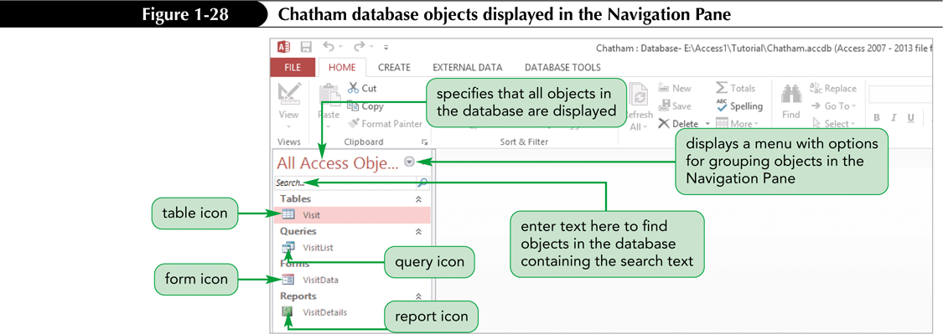
Viewing Objects in the Navigation Pane
The Navigation Pane currently displays the default category, All Access Objects, which lists all the database objects in the pane
Each object type (Tables, Queries, Forms, and Reports) appears in its own group

Slide 43
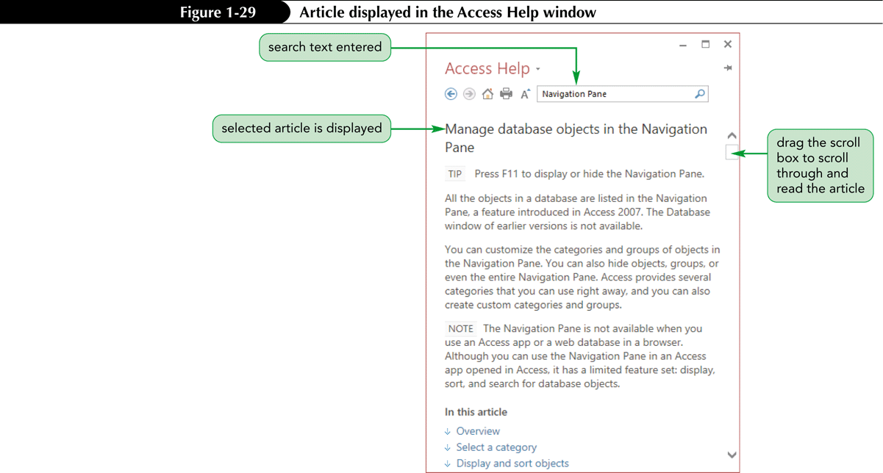
Using Microsoft Access Help
Start Help by clicking the Microsoft Access Help
button in the top right of the Access window, or by pressing the F1 key

Slide 44
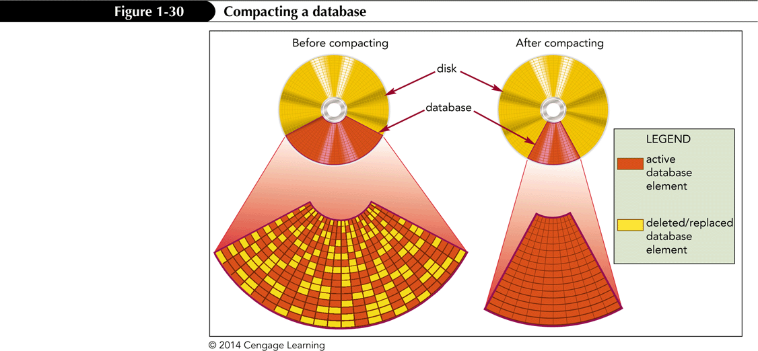
Managing a Database
Activities involved in database management include compacting and repairing a database and backing up and restoring a Database
Compacting and Repairing a Database
Rearranges the data and objects in a database to decrease its file size, thereby making more storage space available and enhancing the performance of the database

Slide 45
Managing a Database (Cont.)
Backing Up and Restoring a Database
The process of making a copy of the database file to protect your database against loss or damage
The Back Up Database command enables you to back up your database file from within the Access program, while you are working
Steps:
Click the FILE tab to display the Info screen in Backstage view
Click Save As in the navigation bar
Click Back Up Database in the Advanced section of the Save Database As pane
Click the Save As button

Slide 46
Excel or Access?
Ask the following questions
Do you need to store data in separate tables that are related to each other?
Do you have a very large amount of data to store?
Will more than one person need to access the data at the same time?
If you answer “yes” to any of these questions, an Access database is most likely the appropriate application to use

